Slide 1
GOES-18 SUVI PS-PVR
SWPC User Perspective
Steven Hill
NOAA/NWS Space Weather Prediction Center

Slide 2
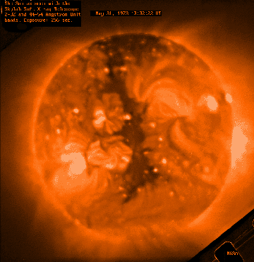
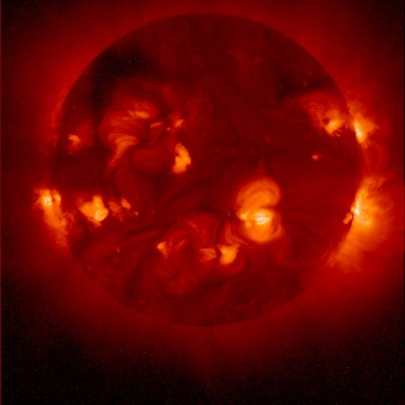
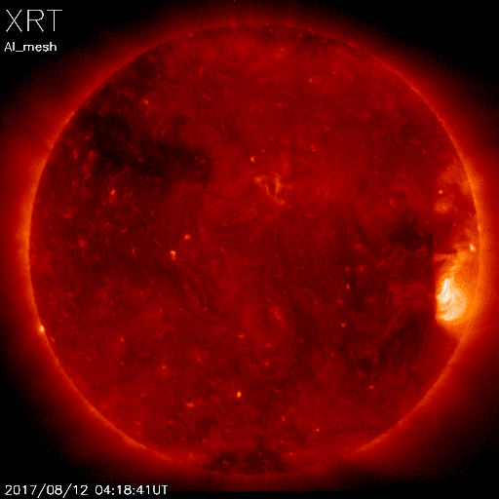
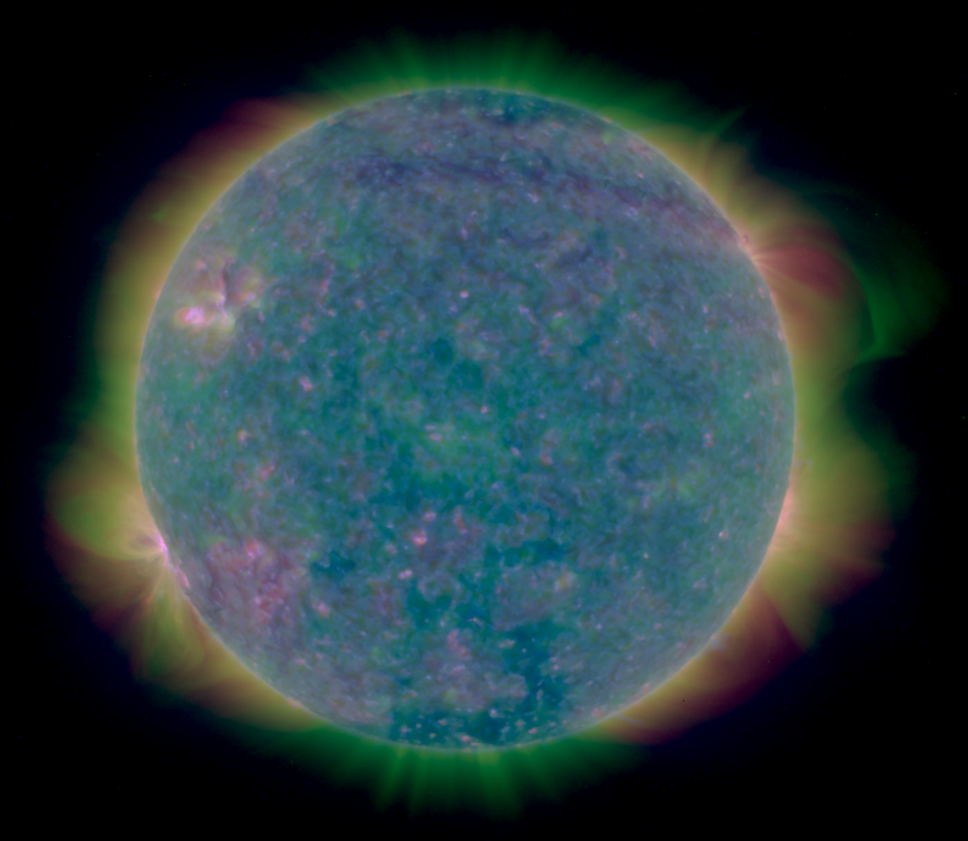
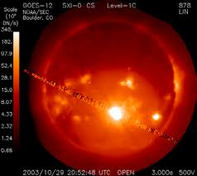
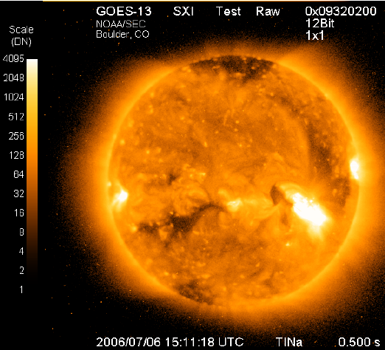
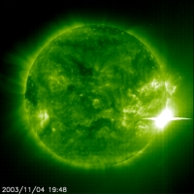
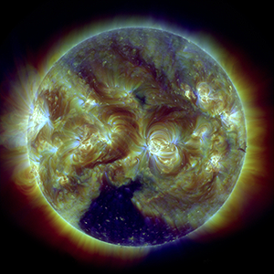
Heritage
Skylab
1973-74
Yokoh 1991-2001
Hinode
2006-
GOES 12
2001-2007
GOES 13-15
2006-2020
SUVI
SOHO EIT
1996-
SDO AIA
2010-
Notes:
First proposed GOES X-ray imager in 1970s
First formal study for what became GOES-12 SXI started in 1980s

Slide 3
Forecast Applications
Provide advance warning of solar activity
“Over the horizon” look at active regions rotating onto the Earth-facing side of the sun
Provide warning of recurring geomagnetic storms
Tracking coronal holes as they rotate across the solar disk
Provide warning of non-recurring geomagnetic storms
Identify, locate, and characterize eruptions (flares, coronal mass ejections)
Provide warning of solar radiation storms
Identify, locate, and characterize eruptions (flares, coronal mass ejections)
Assess solar flaring probability
Intensity and complexity of solar active regions

Slide 4
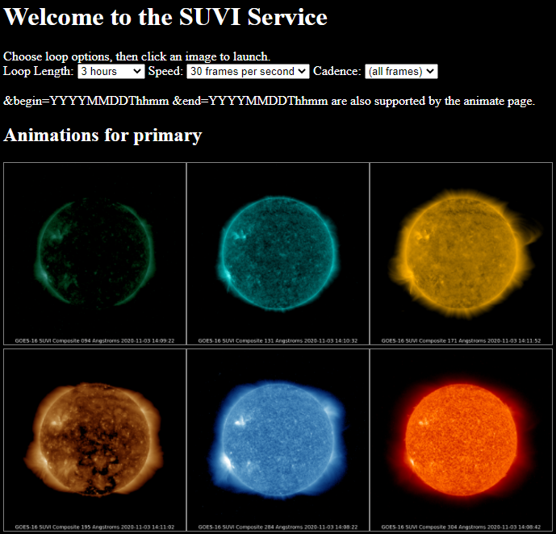
Data
Used primarily for situational awareness
Auto updating loops with selectable
Duration: 3 hrs to 8 days
Speed: 10 to 60 fps
Cadence: 4 min to daily

Slide 5
Data Products
Product | Wavelength (nm) | Uses | Features and Temperature (K)
Composite Images | 9.4 | Flare location | Flares ~6x10⁶ K
 | 13.1 | Flare location | Flares ~6x10⁶ K and ‘hot’ flares ~15x10⁶ K
 | 17.1 | Active region characterization | Active regions ~6x10⁵ K
 | 19.5 | Active region characterization and flare location | Active regions ~1x10⁶ K and ‘hot’ flares ~20x10⁶ K
 | 28.4 | Coronal hole location and characterization | Coronal Holes (~2x10⁶ K)
 | 30.4 | Filament location and characterization | Filaments (~6x10⁴ K)
Thematic Map | All | Supervised pixel classifier | All
Notes:
SWPC doesn’t use the L1b products

Slide 6
GOES 16-17-18 SUVI Status
GOES 16 and 17 SUVIs are the primary and secondary EUV imagers for operations, respectively
SWPC will be prepared for switch of secondary SUVI from GOES-17 to GOES-18 on January 4, 2023
SWPC is preparing for SPADES release 2.1.1 deployment on 12/8 with metadata changes (‘time’ keyword)

Slide 7
Areas of Concern
30.4nm -> 28.4nm cross-talk
Disentanglement of the 30.4 and 28.4 nm channels continues to be of interest to SWPC
ADR 1147
SUVI GPA cannot handle additional flatfields
Remains a concern because of the future potential for off-band light leaks due to pinhole or other filter failures.

Slide 8
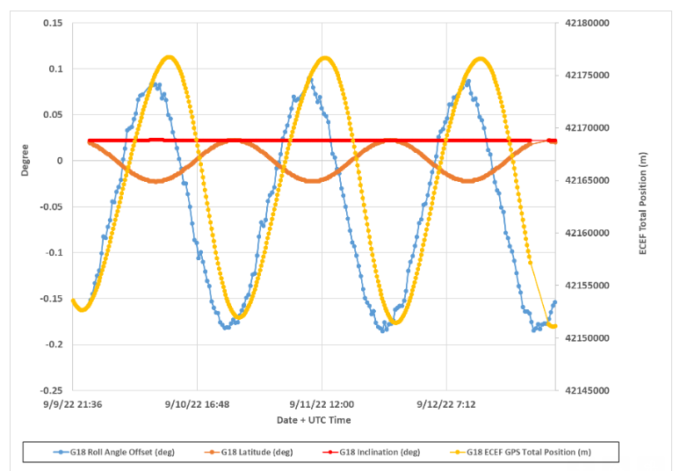
Roll Navigation
GOES 13-15
Residual roll navigation error was anticipated in SUVI (and seen in prior SXIs) due to nadir pointing spacecraft attitude coupling with orbit inclination errors.
For G13-15, the inclination box was 0.5 deg, leading to a roll error of up to 0.5 deg
Unfortunately orbit ephemeris data was not available to ground processing, so it was requested on GOES-R
G16-18
Residual roll error exceeds the inclination error
Thus it can only be partially resolved by rigid body coupling of spacecraft roll and orbit inclination

Slide 9
SUVI & SXI Research Impact (selected)
Seaton, D. B., & Darnel, J. M. (2018). Observations of an Eruptive Solar Flare in the Extended EUV Solar Corona. The Astrophysical Journal, 852, L9. doi:10.3847/2041-8213/aaa28e | 57
Veronig, A. M., Podladchikova, T., Dissauer, K., Temmer, M., Seaton, D. B., Long, D., . . . Kliem, B. (2018). Genesis and Impulsive Evolution of the 2017 September 10 Coronal Mass Ejection. The Astrophysical Journal, 868, 107. doi:10.3847/1538-4357/aaeac5 | 68
Hill, S. M., Pizzo, V. J., Balch, C. C., Biesecker, D. A., Bornmann, P., Hildner, E., . . . Zimmermann, F. (2005). The NOAA Goes-12 Solar X-Ray Imager (SXI) 1. Instrument, Operations, and Data. Solar Physics, 226, 255-281. doi:10.1007/s11207-005-7416-x | 84
Liu, C., Lee, J., Yurchyshyn, V., Deng, N., Cho, K.-s., Karlický, M., & Wang, H. (2007). The Eruption from a Sigmoidal Solar Active Region on 2005 May 13. The Astrophysical Journal, 669, 1372-1381. doi:10.1086/521644 | 68
Temmer, M., Vršnak, B., & Veronig, A. M. (2007). Periodic Appearance of Coronal Holes and the Related Variation of Solar Wind Parameters. Solar Physics, 241, 371-383. doi:10.1007/s11207-007-0336-1 | 91
Veronig, A. M., Karlický, M., Vršnak, B., Temmer, M., Magdalenić, J., Dennis, B. R., . . . Pötzi, W. (2006). X-ray sources and magnetic reconnection in the X3.9 flare of 2003 November 3. Astronomy and Astrophysics, 446, 675-690. doi:10.1051/0004-6361:20053112 | 121
Warmuth, A., Mann, G., & Aurass, H. (2005). First Soft X-Ray Observations of Global Coronal Waves with the GOES Solar X-Ray Imager. The Astrophysical Journal, 626, L121-L124. doi:10.1086/4317 | 65
Rotter, T., Veronig, A. M., Temmer, M., & Vršnak, B. (2012). Relation Between Coronal Hole Areas on the Sun and the Solar Wind Parameters at 1 AU. Solar Physics, 281, 793-813. doi:10.1007/s11207-012-0101-y | 66

Slide 10
Summary
GOES-R SUVIs have been an overall success so far (16-18)
Updating SWPC software for SPADES 2.1.1 release
SWPC will be prepared for January 4th switch to GOES-18
Areas of concern
Need to be prepared for light leaks in the future
Desired to address 28.4-30.4 ‘mixing’
Address roll navigation error, could be a software fix on the ground with ‘simple’ ephemeris & attitude data (rigid body)
Thank you to NCEI & the GOES Program!
For their persistence in overcoming issues and improving products
For pursuing improvement by engaging with the research community

